Slide 1
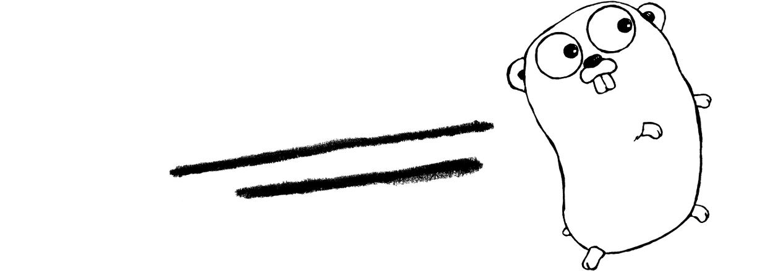
GO
Marc Deaso
Joshua Itagaki
Christopher Kang

Slide 2
History of Go
First appeared November 2009.
Developed by Google.
Robert Griesemer, Rob Pike, & Ken Thompson
Widely used as a systems language in widely distributed systems and network servers.
Created with the intent of resolving issues in other languages while maintaining other languages positives.
Dislike of C++ complexity
Two main compiler implementations: Gc, and Gccgo.
Mascot is a gopher.
By: Renée French

Slide 3
Language Characteristics and Features
Basic syntax from C
Declaration and packages from Pascal/Modula/Oberon family
Language inspired by Tony Hoare’s CSP
Newsqueak and Limbo(concurrency)

Slide 4
Language Characteristics and Features (cont.)
Not object oriented, but supports packages and methods.
Concurrency.
Garbage collection.
Type inference.
Very fast compilation times.
Multiple assignment, and function return.
Very new language that is open source

Slide 5
Packages
Every Go program is made up of packages
Start running on package main
Packages uses import paths
Such as “fmt” and “math/rand”
import (
"fmt"
"math"
)

Slide 6
Functions
func
Can take zero or more arguments
Type comes AFTER variable name
x, y int
func add(x int, y int) int {
return x + y
}

Slide 7
Functions(cont.)
Can return any number of results
Return values may also be named
func swap(x, y string) (string, string) {
return y, x
}
Return statement without arguments returns named return values(“naked” return)
func split(sum int) (x, y int) {
x = sum * 4 / 9
y = sum - x
return
}

Slide 8
Variables
var declares a list of variables and type is last
var a, b, c bool
var declaration can include intializers
var i, j int = 1, 2
Short assignment statement can be used instead of var
stmt := 6

Slide 9
Basic Types
bool, int, uint, string, float32, float64, complex128
int and uint can take in 8bit 16bit or 64bit
Any undeclared type will have a zero value
0 for numeric types
False for bool
“ “(empty string) for strings

Slide 10
Type Conversion and Constants
Items of different types requires an explicit conversion
i := 42
f := float64(i)
u := uint(f)
Constants are declared using const
Cannot be declared using :=
const Pi = 3.14

Slide 11
Pointers and Structs
Uses pointers and operands
var p *int
i := 4
p = &i
Struct fields can be accessed through struct pointers

Slide 12
Package net
Portable interface for network I/O
Dial function connects to a server
conn, err := net.Dial("tcp", "golang.org:80")
Listen function creates a server
listener, err := net.Listen("tcp", ":40800")

Slide 13
Arrays
Denoted with variable then ends with the type
var a[5]int
Can use slice to make a dynamically-sized flexible view in an array
Does not store values, but rather reads a section of the array
Slice can return a length or a capacity
a[0:5]
make function creates a dynamically sized array
a := make([]int, 0, 7) //length of 0 capacity of 7

Slide 14
Goroutines
Goroutines are like lightweight threads.
They start with tiny stacks and resize as needed.
Go programs can have hundreds of thousands of them.
Start a goroutine using the go statement:
The Go runtime schedules goroutines onto OS threads.
Blocked goroutines don't use a thread.

Slide 15
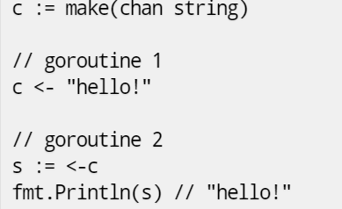
Channels
Channels provide communication between goroutines.
Multi-tasking != Parallelism

Slide 16
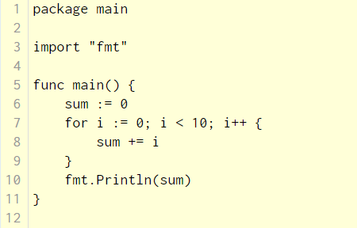
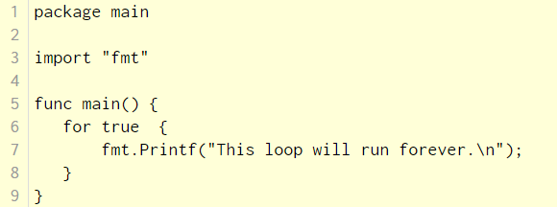
Loops
The for loop is the only one looping construct in Go

Slide 17
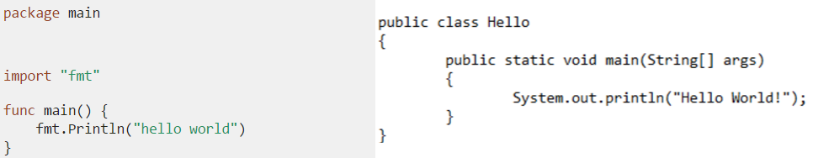
Go v.s. Java
Go requires package
Go requires import statement
Go does not use semicolons...sometimes
8 vs 12

Slide 18
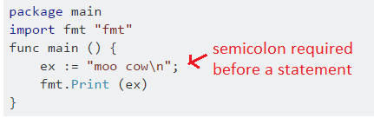
Semicolons in Go
Elements of a list of statements are separated by semicolon
Unless the previous statement ends with ) or }

Slide 19
Our Application
Server-Client based Chat application.
Uses concurrency
Server written in go, chat program in java

Slide 20
Works Cited
https://golang.org/
https://en.wikipedia.org/wiki/Go_(programming_language)

